Slide 1



Graph Query Generation with Constraint-guided
Large Language Agents
Mengying Wang^{1*}, Nicolaas Jedema², Rahul Pandey², RaviKiran Krishnan^{3*}, Jens Lehmann^{2,4}, Yinghui Wu¹
¹Case Western Reserve University, ²Amazon AGI, ³Meta, ⁴TU Dresden
*Work done while at Amazon AGI
Notes:
So I'm happy to talk about our work on how LLMs can be better exploited to generate structured queries to support natural language questions and answering in graphs. This is a student work w. Mengying Wang and Amazon AGI team. The problem sets of translating NL to structured queries such as SQL are not new; yet our focus is on converting NL queries to graph queries such as Cypher and SPARQL, more involved than SQL with graph pattern semantics. We show that LLMs can improve this task if properly guided by data constraints.

Slide 2
Support Knowledge Graph QA w. Structured Graph Queries
→
Extracts surface relations directly from the question. Looks for a literal TREAT_ON edge.
→
Schema-aware fine-tuning finds INDICATE_FOR, but returns unapproved drugs.
→
Captures implicit intent (Approved=True) and respects the ontology.
The goal is not only syntactic validity ——
It is an executable query that respects both KG topology and pragmatic intent.
2
UniQGen · ICDE 2026

Slide 3




NL to Structured Graph Queries: SOTA & Challenges
Hallucination (LLM-based)
Missing Constraints (Rule-based)
Generated queries don't match the KG's schema or topology
Implicit user intent lost
(e.g., "Approved=True" filter dropped)
High Maintenance
Language Lock-in
Schema-specific fine-tuning is brittle and costly on large and evolving graphs
A separate model per query language is expensive
UniQGen: a training-free, schemaless generator that preserves user intent and renders executable queries for multiple graph query classes.
3
UniQGen · ICDE 2026
Notes:
What are options?
Completely outsource the task to LLMs – hallucination
Assume full, predefinded constraints or following rules – too restrictive and may miss opportunities
Have fixed schema makes it harder to be adapted to dynamic, context and text rich graphs.
Maintaining multiple solutions case by case is not practical and not scalable.

Slide 4
Notations & Problem Statement
Key Concepts
Quality Measures
Knowledge Graph G = (V, E)
Entities V, typed edges E as triples ⟨s, p, o⟩
LLM-Sound
Q(G) ⊆ G(A)
No spurious answers
Constraint Table C (CTable)
LLM-Complete
G(A) ⊆ Q(G)
Typed triple patterns and value/intent constraints, each with uncertainty score u ∈ [0,1]
All answers covered
Reference Set G(A)
Consistent
Every binding in Q(G)
satisfies all c ∈ C
KG entities corresponding to oracle-provided answer set A
Constraints respected
Minimal
No redundant constraints
Query Result Q(G)
Concise queries
Induced answer set for graph query Q over G
Goal: Given an NL query Q_{n}, reference answer set A, KG G, and CTable C extracted from Q_{n} , generate a query Q that is (i) consistent with C, (ii) jointly maximizes LLM-complete & LLM-sound, and (iii) minimal.
4
UniQGen · ICDE 2026

Slide 5
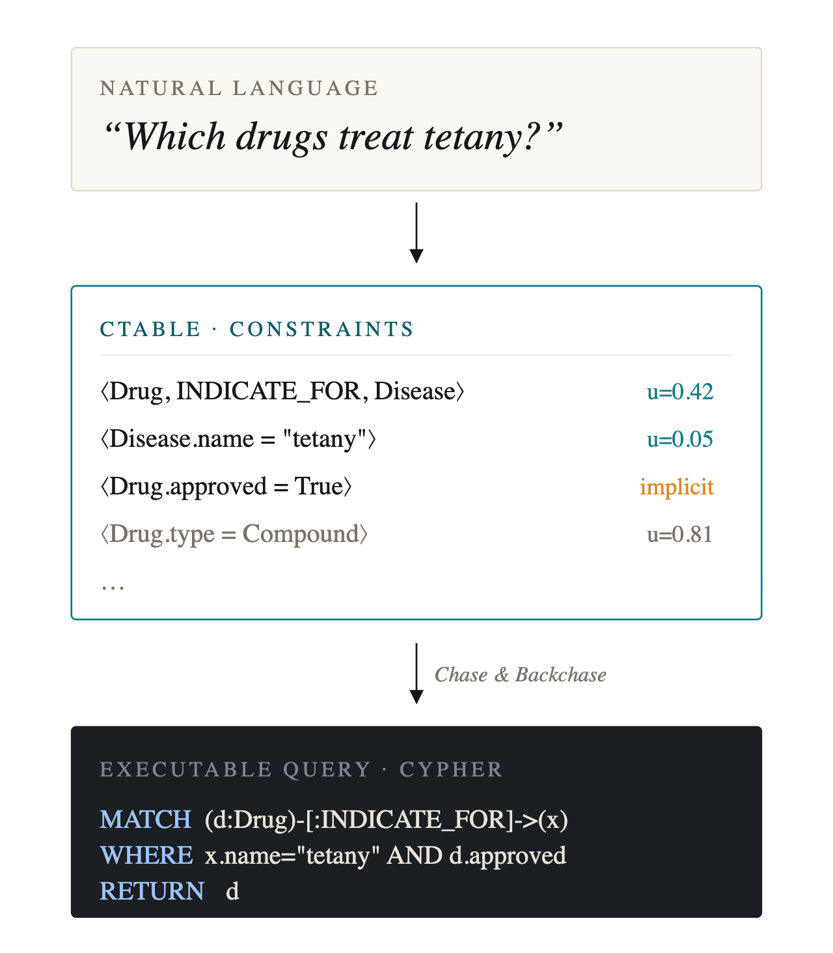
UniQGen
A unified graph‑query generation framework.
→
LLM agents extract and refine constraints from the knowledge base interactively;
→
A budgeted "Chase & Backchase" loop with relative quality guarantees;
→
Supports multiple query languages with an LLM-assisted pluggable renderer.
5
UniQGen · ICDE 2026

Slide 6
UniQGen Framework Overview
1. Factual extraction
Entity linking + k-hop subgraph
2. CTable construction
Agent a₁ extracts and scores constraints
3. Chase & Backchase
Agent a₂ searches over constraint subsets
4. Rendering
Pluggable renderer → Cypher / SPARQL
6
UniQGen · ICDE 2026

Slide 7
Module 1: CTable Construction
Language-agnostic intermediate representation for graph queries
Example: “Which cities in the USA hosted the Olympics in February?”
ID
Constraint candidate
Role
Uncertainty Scoring
c₁
(c:City)-[:hosted]->(e:OlympicGames)
topology
For each constraint cᵢ:
uᵢ = nᵢ / m
c₂
c.country = "USA"
value filter
c₃
e.year > 1896
temporal filter
nᵢ = match count of cᵢ in G
m = max match count
Higher u → less specific
u = 0 → pruned
c₄
e.type = "Winter"
implicit intent
c₅
e.type = "Summer"
value filter
👉 Normalized to a monotone core, dropping a constraint can only enlarge the answer set.
7
UniQGen · ICDE 2026

Slide 8
Module 2: Constraint-guided Query Generation
QChase (Top-down) — Completeness-Guided Beam Search
Goal: Derive universal query Q_{U} ensuring G(A) ⊆ Q_{U}(G) — maximize LLM-complete
1
→
2
→
3
→
4
Start with Q₀ enforcing all
constraints in CTable C₀
Spawn children by removing
one constraint at a time
Score: s'(c,Q) = α(1-c.u)
+ (1-α)Q.p
Keep top-b candidates;
repeat until p ≥ τ
QBackchase (Bottom-up) — Soundness & Minimality
Goal: Derive minimal query Q_{M} ensuring Q_{M}(G) ⊆ G(A) — maximize LLM-sound
4
→
3
→
2
→
1
Output minimal query Q_{M}
Evaluator verifies soundness
against reference set A
Iteratively combine
subqueries via beam search
Decompose Q_{U} into single-
constraint subqueries
8
UniQGen · ICDE 2026
Notes:
This process ensures high-quality queries by first relaxing constraints to achieve full coverage of the reference answer set, then carefully combining atomic constraints into minimal queries that introduce as few irrelevant matches as possible, approaching soundness to reference sets.

Slide 9


Deployment on Amazon Neptune
Architecture
Cost Control & Guardrails
Freebase (2.9B triples, 116M entities) on Neptune
Batched evaluator (1 LLM call/beam step)
openCypher-over-RDF: dual-language endpoint
Parallel candidate generation + execution
AWS EC2 c5.4xlarge with autoscaling
Bounded beam width/depth + early stopping
LangChain agents via Amazon Bedrock
Cached entity links & subgraphs
Model-agnostic across LLM providers
Auto-tunable beam parameters
Portability: (i) Training-free → adapt to new KG by updating synonym/hint lists. (ii) Pluggable renderer emits Cypher or SPARQL from the same plan. (iii) IaC recipe + benchmark harness provided for rapid deployment.
9
UniQGen · ICDE 2026

Slide 10
Experimental Setup
Benchmarks
Dataset | Test Size | Train:Test | Characteristics
GraphQ | 2,395 | ≈ 0.99 | Characteristic-rich, low-resource
GrailQA | 6,763 | ≈ 6.56 | I.I.D. / Compositional / Zero-shot
WebQSP | 1,639 | ≈ 1.89 | Diverse, amenable to ICL
* All methods query the same Neptune-hosted Freebase. Same entity linking for fair comparison.
Methods Compared
UniQGen (Ours) [Training-free] LLM-based generator + CaB refinement; cross-language (SPARQL / Cypher);
Pangu [Trained] SOTA hybrid of symbolic search + schema-fine-tuned LM; SPARQL only;
ArcaneQA [Trained] Step-wise SPARQL decoder; re-encodes relevant KG schema at each step; SPARQL only;
Prompt-Only [Training-free] Same prompt as UniQGen's generator, no CaB refinement.
10
UniQGen · ICDE 2026

Slide 11
Effectiveness
vs. Pangu (fine‑tuned SOTA)
+31.6 %
F1 GAIN ON GRAPHQ
+4.9 %
F1 GAIN ON GRAILQ
Largest gains on GraphQ, where train:test ≈ 0.99 — the lowest among the three;
On WebQSP, where in-context learning baselines benefit most, UniQGen remains on par (0.794 vs 0.793).
UniQGen is training-free; Pangu and ArcaneQA require task-specific fine-tuning.
11
UniQGen · ICDE 2026

Slide 12
In-depth Analysis
• Robust on multi-hop: all methods degrade as hop count grows, but UniQGen degrades the slowest on GraphQ.
• Bimodal F1: failures are concentrated — UniQGen either nails the plan or misses one critical constraint.
• Universal favors recall, Minimal favors precision: neither always wins, so picking the better one per query helps.
Runtime validation absorbs oracle noise: oracle agrees with ground-truth ~80% of the time, yet F1 drops only 3.9%.
Reference Set
P
R
F1
EM
3.9 %
LLM oracle
0.813
0.857
0.804
0.740
Ground-truth
0.833
0.898
0.835
0.800
F1 loss vs. ground-truth oracle
Oracle ablation (GraphQ): swap LLM oracle for ground-truth.
12
UniQGen · ICDE 2026

Slide 13
Efficiency & Scalability
Zero
~40s
0.25s
1500+
task-specific training
for new benchmarks
Avg. query
generation time
P50 KG execution
latency (Minimal)
Concurrent requests
with stable latency
Including CaB loop
P95: 0.28s
No degradation observed
13
UniQGen · ICDE 2026

Slide 14
Summary
i.
ii.
iii.
UniQGen pipeline
Constraint‑based reformulation
Open resources
Constraint extraction → CTable → Chase & Backchase refinement;
Schema-less, unified KGQA at low latency; and
No fine-tuning required.
LLM agents explore and rank candidate constraints via beam search;
Chase & Backchase enforces LLM-complete, LLM-sound, and minimality; and
Extends to other query languages with modest effort.
A Neptune‑ready Freebase snapshot over SPARQL/Cypher;
A one‑step deployment recipe; and
Gold Cypher pairs aligned with SPARQL benchmarks.
14
UniQGen · ICDE 2026

Slide 15

Thank You!
Contact: mxw767@case.edu (Mengying Wang)

Slide 16


Roadmap
Motivation
1
Why unified KGQA?
2
Problem Formulation
Constraints & Quality Measures
Framework
3
UniQGen: CTable + Chase & Backchase
4
Deployment & Experiments
Amazon Neptune + GrailQA, GraphQ, WebQSP
Conclusion
Major Contributions

Slide 17
Roadmap
Motivation
Why unified KGQA?
2
Problem Formulation
Constraints & Quality Measures
Framework
3
UniQGen: CTable + Chase & Backchase
4
Deployment & Experiments
Amazon Neptune + GrailQA, GraphQ, WebQSP
Conclusion
5
Major Contributions
Notes:
Our motivation starts with a painpoint that NL queries have more sutble ambiguity involved when one wants to support KGQA with NL statements than its counterpart over tables. And industry often have various yet isolated solution to independent choices of graph query models.

Slide 18
Motivation: Knowledge‑graph QA Lives in Two Parallel Worlds
Academic KGQA benchmarks largely assume RDF/SPARQL; enterprise stacks increasingly need LPG/Cypher too.
Natural-language
User Intent
RDF · SPARQL
LPG · Cypher
Benchmark Ecosystem
Production Ecosystem
GRAPH–MODEL LOCK‑IN
Once an organization commits to a paradigm, the choice propagates to every layer — language, tooling, expertise.
Migration is costly and risky.
18
UniQGen · ICDE 2026

Slide 19
Roadmap
Motivation
1
Why unified KGQA?
Problem Formulation
Constraints & Quality Measures
Framework
3
UniQGen: CTable + Chase & Backchase
4
Deployment & Experiments
Amazon Neptune + GrailQA, GraphQ, WebQSP
Conclusion
5
Major Contributions

Slide 20
Roadmap
Motivation
1
Why unified KGQA?
2
Problem Formulation
Constraints & Quality Measures
Framework
UniQGen: CTable + Chase & Backchase
4
Deployment & Experiments
Amazon Neptune + GrailQA, GraphQ, WebQSP
Conclusion
5
Major Contributions

Slide 21
Roadmap
Motivation
1
Why unified KGQA?
2
Problem Formulation
Constraints & Quality Measures
Framework
3
UniQGen: CTable + Chase & Backchase
Deployment & Experiments
Amazon Neptune + GrailQA, GraphQ, WebQSP
Conclusion
5
Major Contributions

